Slide 1
Bayes’ Theorem, Bayesian Networks and Hidden Markov Model
Ka-Lok Ng
Asia University

Slide 2
Bayes’ Theorem
Events A and B
Marginal probability, p(A), p(B)
Joint probability, p(A,B)=p(AB)=p(A∩B)
Conditional probability
p(B|A) = given the probability of A, what is the probability of B
p(A|B) = given the probability of B, what is the probability of A
http://www3.nccu.edu.tw/~hsueh/statI/ch5.pdf

Slide 3
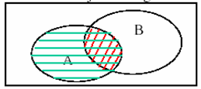
Bayes’ Theorem
General rule of multiplication
p(A∩B)=p(A)p(B|A)
= event A occurs *(after A occurs, then event B occurs)
=p(B)p(A|B) = event B occurs *(after B occurs, then event A occurs)
Joint = marginal * conditional
Conditional = Joint / marginal
P(B|A) = p(A∩B) / p(A)
How about P(A|B) ?

Slide 4
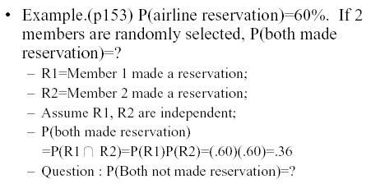
Bayes’ Theorem

Slide 5
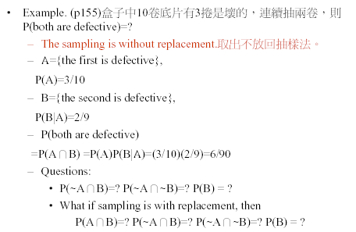
Bayes’ Theorem
Given 10 films, 3 of them are defected. What is the probability two successive films are defective?
7 Good
3 Defects

Slide 6

Bayes’ Theorem
Loyalty of managers to their employer.

Slide 7
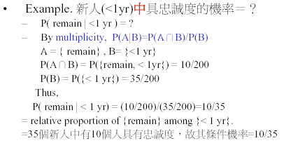
Bayes’ Theorem
Probability of new employee loyalty

Slide 8
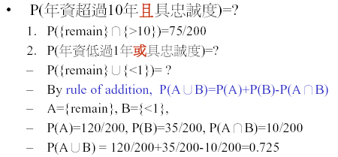
Bayes’ Theorem
Probability (over 10 year and loyal) = ?
Probability (less than 1 year or loyal) = ?

Slide 9
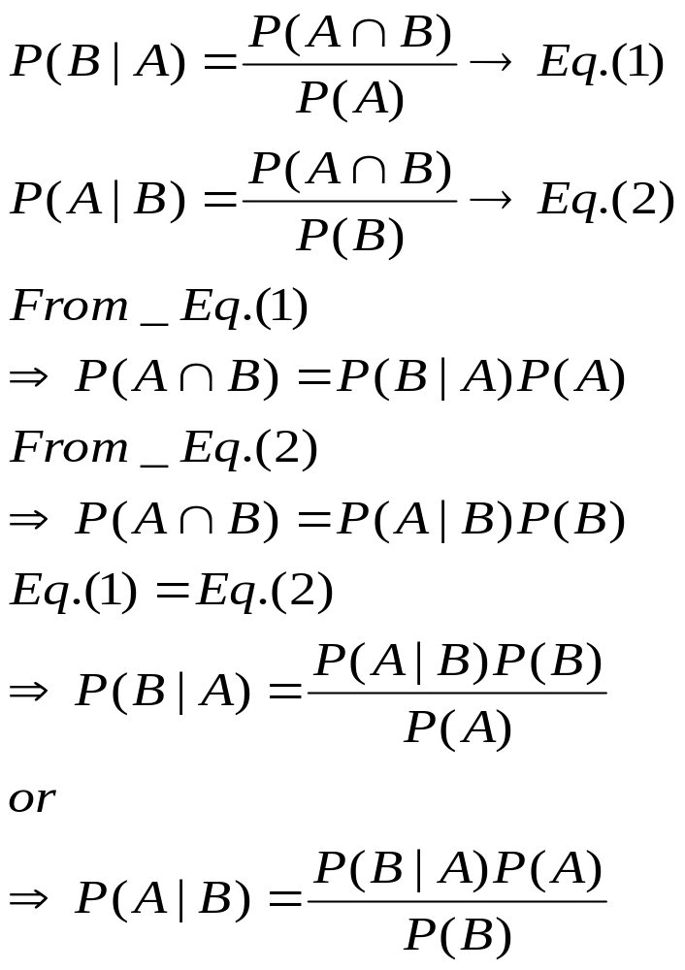
Bayes’ Theorem
Probability of an event B occurring given that A has occurred has been transformed into a probability of an event A occurring given B has occurred.

Slide 10
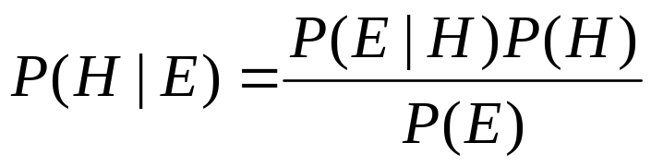
Bayes’ Theorem
H is hypothesis
E is evidence
P(E|H) is the likelihood, which gives the probability of the evidence E assuming H
P(H) – prior probability
P(H|E) – posterior probability

Slide 11
Bayes’ Theorem
 | Male students (M) | Female students (F)
Wear glass (G) | 10 | 20 | 30
Not wear glass (NG) | 30 | 40 | 70
 | 40 | 60 | 100
What is the probability that given a student who wear glass is male student?
P(M|G) = ?
We know from the table, the probability is
= 10/30
Use Bayes’ Theorem
P(M|G) = P(M and G) / P(G)
= [10/100 ] / 30/100
= 10/30

Slide 12
Bayes’ Theorem
Let E₁, E₂ and E₃
= a person is currently employed, unemployed, and not in the labor force respectively
P(E₁) = 98917 / 163157 = 0.6063
P(E₂) = 7462 / / 163157 = 0.0457
P(E₃) = 56778 / 163157 = 0.3480
Let H = a person has a hearing impairment due to injury, what are P(H), P(H|E₁), P(H|E₂) and P(H|E₃) ?
P(H) = 947 / 163157 = 0.0058
P(H|E₁) = 552 / 98917 = 0.0056
P(H|E₂) = 27 / 7462 = 0.0036
P(H|E₃) = 368 / 56778 = 0.0065
Employment status | Population | Impairments
Currently employed | 98917 | 552
Currently unemployed | 7462 | 27
Not in the labor force | 56778 | 368
Total | 163157 | 947

Slide 13
Bayes’ Theorem
H = a person has a hearing impairment due to injury
What is P(H)?
May be expressed as the union of three mutually exclusively events, i.e. E₁∩H, E₂∩H, and E₃∩ H
H = (E₁∩H)∪(E₂∩H)∪(E₃∩ H)
Apply the additive rule
P(H) = P(E₁∩H) + P(E₂∩H) + P(E₃∩ H)
Apply the Bayer’ theorem
P(H) = P(E₁) P(H|E₁) + P(E₂) P(H|E₂) + P(E₃) P(H|E₃)
Event | P(E_{i}) | P(H | E_{i}) | P(E_{i}) P(H | E_{i})
E₁ | 0.6063 | 0.0056 | 0.0034
E₂ | 0.0457 | 0.0036 | 0.0002
E₃ | 0.3480 | 0.0065 | 0.0023
P(H) |  |  | 0.0059

Slide 14
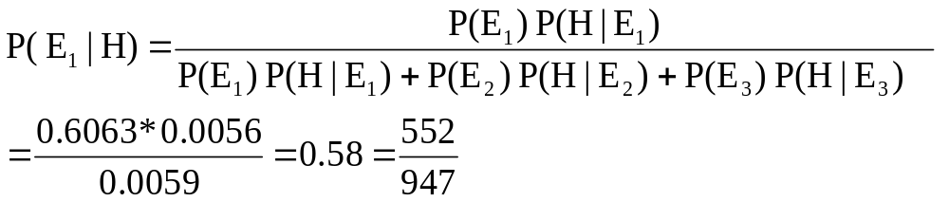
Bayes’ Theorem
The more complicate method
P(H) = P(E₁) P(H|E₁) + P(E₂) P(H|E₂) + P(E₃) P(H|E₃) ………………. (1)
is useful when we are unable to calculate P(H) directly.
How about we want to compute P(E₁|H) ?
The probability that a person is currently employed given that he or she has a hearing impairment.
The multiplicative rule of probability states that
P(E₁∩H) = P(H) P(E₁ | H) ➔ P(E₁ | H) = P(E₁∩ H) / P(H)
Apply the multiplicative rule to numerator, we have
P(E₁ | H) = P(E₁) P(H | E₁) / P(H) ……………………………………..(2)
Substitute (1) into (2), we have the expression for Bayes’ Theorem

Slide 15
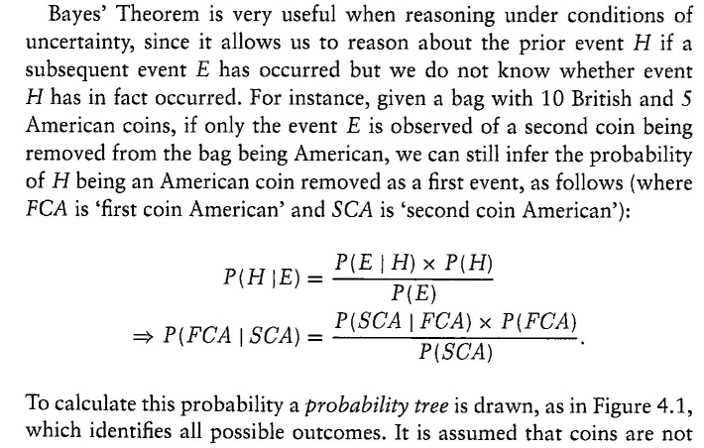
Bayes’ Theorem

Slide 16
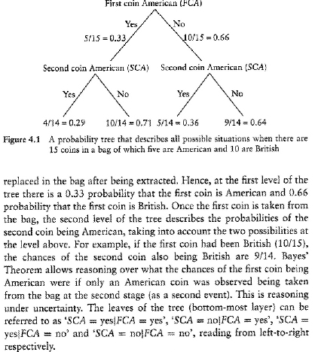

Slide 17
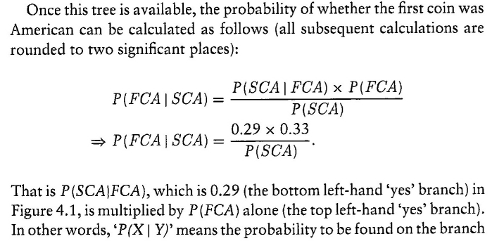
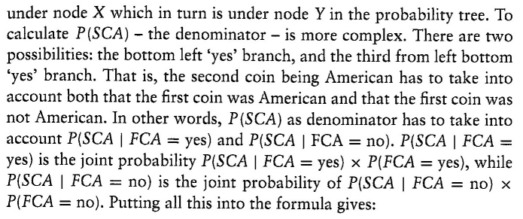

Slide 18
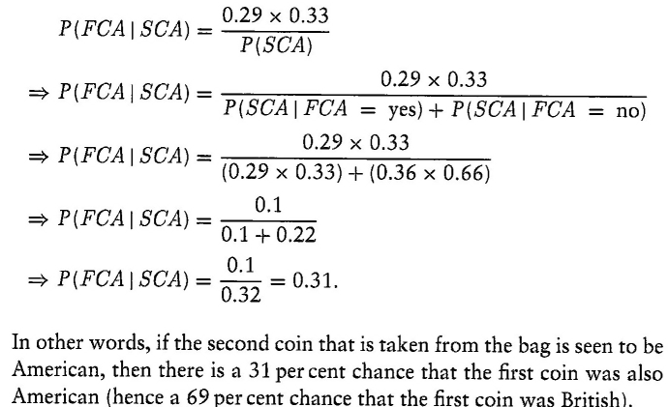

Slide 19
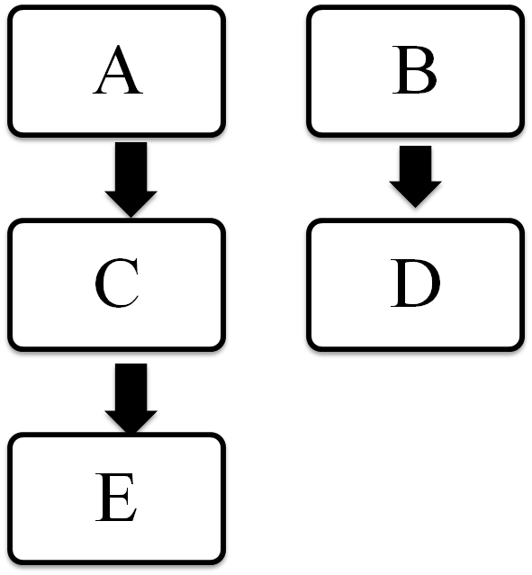

Bayesian Networks (BNs)
What is BN?
– a probabilistic network model
– Nodes are random variables, edges indicate the dependence of the nodes
Node C follows from nodes A and B
Nodes D and E follow the value of B and C respectively.
– allows one to construct predictive model from heterogeneous data
– Estimates of probability of a response given an input condition, such as A, B
Applications of BNs - biological network, clinical data, climate predictions

Slide 20

Bayesian Networks (BNs)
Conditional Probability Table (CPT)
A
B
A | B | P(C=1)
0 | 0 | 0.02
0 | 1 | 0.08
1 | 0 | 0.06
1 | 1 | 0.88
B | P(D=1)
0 | 0.01
1 | 0.9
C
D
C | P(E=1)
0 | 0.03
1 | 0.92
E
Node C approximates a Boolean AND function.
D and E probabilistically follow the values of B and C respectively.
Question: Given full data on A, B, D and E, we can estimate the behavior of C.

Slide 21
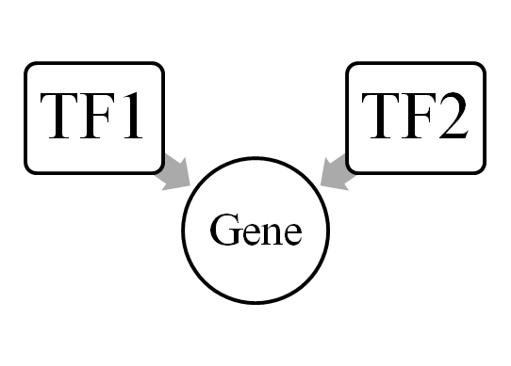
Bayesian Networks (BNs)
 | TF2 | on |  | Off
 | TF1 | on | off | on | Off
Gene | On | 0.99 | 0.4 | 0.6 | 0.02
 | Off | 0.01 | 0.6 | 0.4 | 0.98
P(TF1=on, TF2=on | Gene=on) = 0.99 / (0.99+0.4+0.6+0.02) = 0.49
P(TF1=on, TF2=off | Gene=on) = 0.6 / (0.99+0.4+0.6+0.02) = 0.30
P(Gene=on | TF1=on, TF2=on ) = 0.99
Chain Rule – expressing joint probability in terms of conditional probability
P(A=a, B=b, C=c) = P(A=a | B=b, C=c) * P(B=b, C=c)
= P(A=a | B=b, C=c) * P(B=b | C=c) * P(C=c)

Slide 22
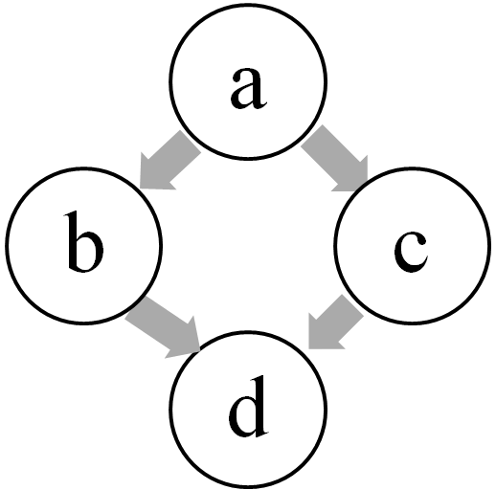
Bayesian Networks (BNs)
P(a)
P(a=U) | P(a=D)
0.7 | 0.3
P(c|a)
a | P(c=U) | P(c=D)
U | 0.6 | 0.4
D | 0.99 | 0.01
P(b|a)
a | P(b=U) | P(b=D)
U | 0.8 | 0.2
D | 0.5 | 0.5
P(d|b,c)
b | c | P(d=U) | P(d=D)
U | U | 1.0 | 0.0
U | D | 0.7 | 0.3
D | U | 0.6 | 0.4
D | D | 0.5 | 0.5
Gene expression: Up (U) or Down (D)
Joint probability, P(a=U, b=U, c=D, d=U) = ??
= P(a=U) P(b=U | a=U) P(c=D | a=U) P(d=U | b=U, c=D)
= 0.7 * 0.8 * 0.4 * 0.7
= 16%

Slide 23
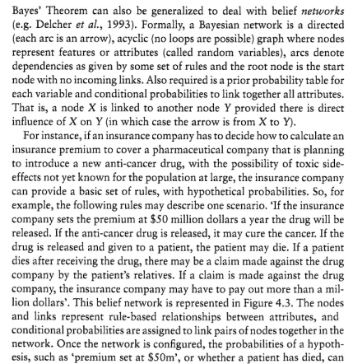
Bayesian Networks (BNs)
保險費

Slide 24
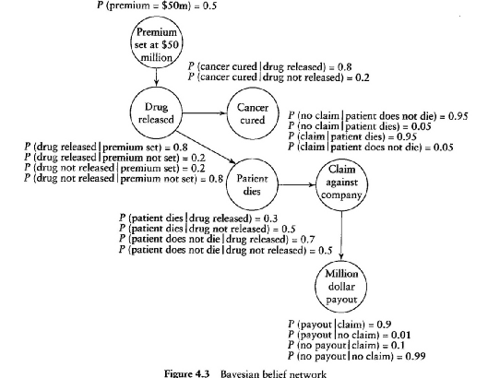
Bayesian Networks (BNs)

Slide 25
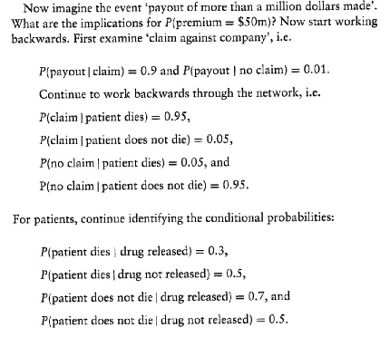
Bayesian Networks (BNs)
Premium
↑
Drug
↑
Patient
↑
Claim
↑
Payout

Slide 26
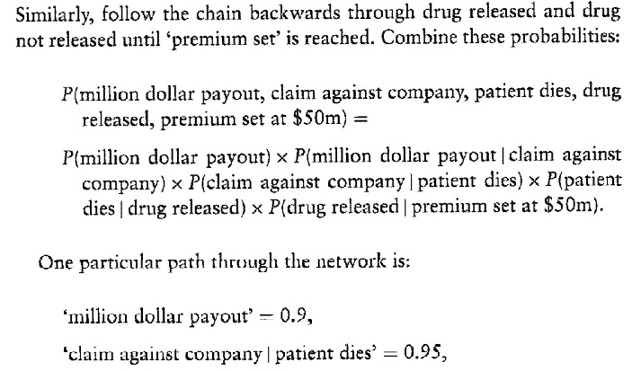
Bayesian Networks (BNs)
Premium
↑
Drug
↑
Patient
↑
Claim
↑
Payout

Slide 27
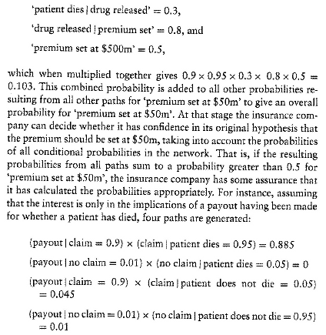
Bayesian Networks (BNs)
Premium
↑
Drug
↑
Patient
↑
Claim
↑
Payout

Slide 28
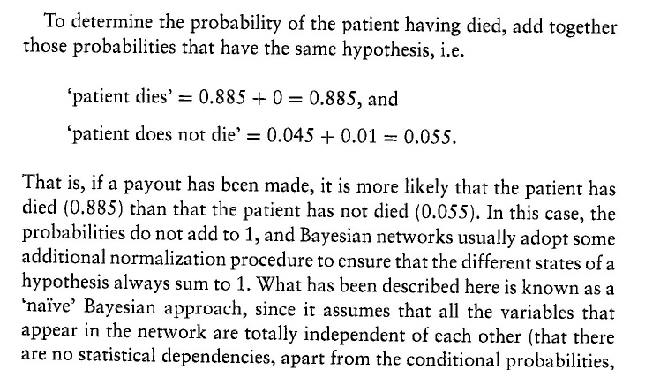
Bayesian Networks (BNs)
Premium
↑
Drug
↑
Patient
↑
Claim
↑
Payout

Slide 29
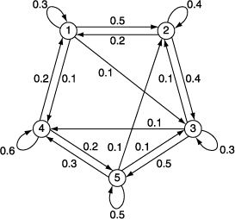
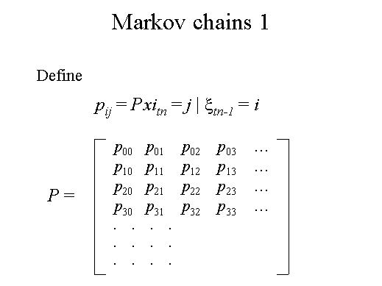
Hidden Markov Models
The occurrence of a future state in a Markov process depends on the immediately preceding state and only on it.
The matrix P is called a homogeneous transition or stochastic matrix because all the transition probabilities p_{ij} are fixed and independent of time.

Slide 30
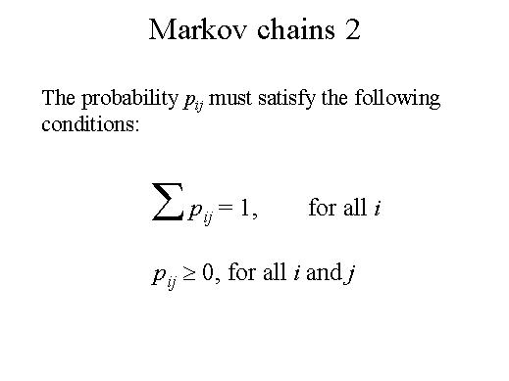
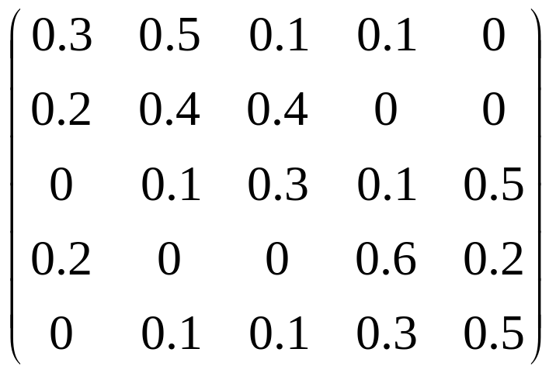
Hidden Markov Models
p_{1j}

Slide 31
Hidden Markov Models
A transition matrix P together with the initial probabilities associated with the states completely define a Markov chain.
One usually thinks of a Markov chain as describing the transitional behavior of a system over equal intervals.
Situations exist where the length of the interval depends on the characteristics of the system and hence may not be equal. This case is referred to as imbedded Markov chains.

Slide 32
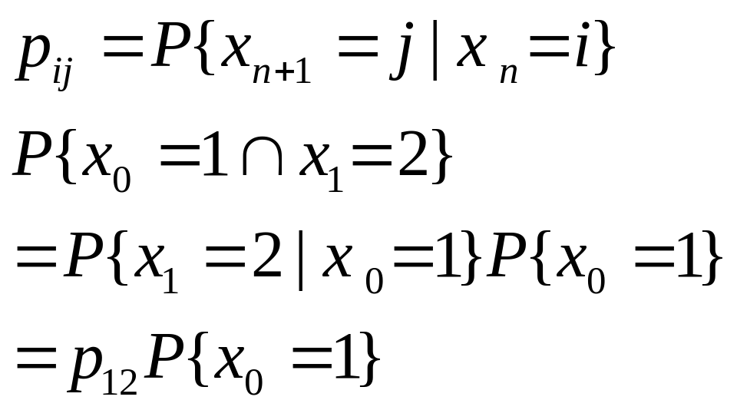
Hidden Markov Models
Let (x₀, x₁, ….x_{n}) denotes the random sequence of the process
Joint probability is not easy to calculate.
More easy with calculating conditional probability

Slide 33
Hidden Markov Models
HMMs – allow for local characteristics of molecular seqs. To be modeled and predicted within a rigorous statistical framework
Allow the knowledge from prior investigations to be incorporated into analysis
An example of the HMM
Assume every nucleotide in a DNA seq. belongs to either a ‘normal’ region (N) or to a GC-rich region (R).
Assume that the normal and GC-rich categories are not randomly interspersed with one another, but instead have a patchiness that tends to create GC-rich islands located within larger regions of normal sequence.
NNNNNNNNNRRRRRNNNNNNNNNNNNNNNNNRRRRRRRNNNN
TTACTTGACGCCAGAAATCTATATTTGGTAACCCGACGGCTA

Slide 34
Hidden Markov Models
The states of the HMM – either N or R
The two states emit nucleotides with their own characteristic frequencies. The word ‘hidden’ refers to the fact that the true states is unobserved, or hidden.
seq. → 60% AT, 40% GC → not too far from a random seq.
If we focus on the red GC-rich regions → 83% GC (10/12), compared to a GC frequency of 23% (7/30) in the other seq.
HMMs – able to capture both the patchiness of the two classes and the different compositional frequencies within the categories.

Slide 35
Hidden Markov Models
HMMs applications
Gene finding, motif identification, prediction of tRNA, protein domains
In general, if we have seq. features that we can divide into spatially localized classes, with each class having distinct compositions HMMs are a good candidate for analyzing or finding new examples of the feature.

Slide 36
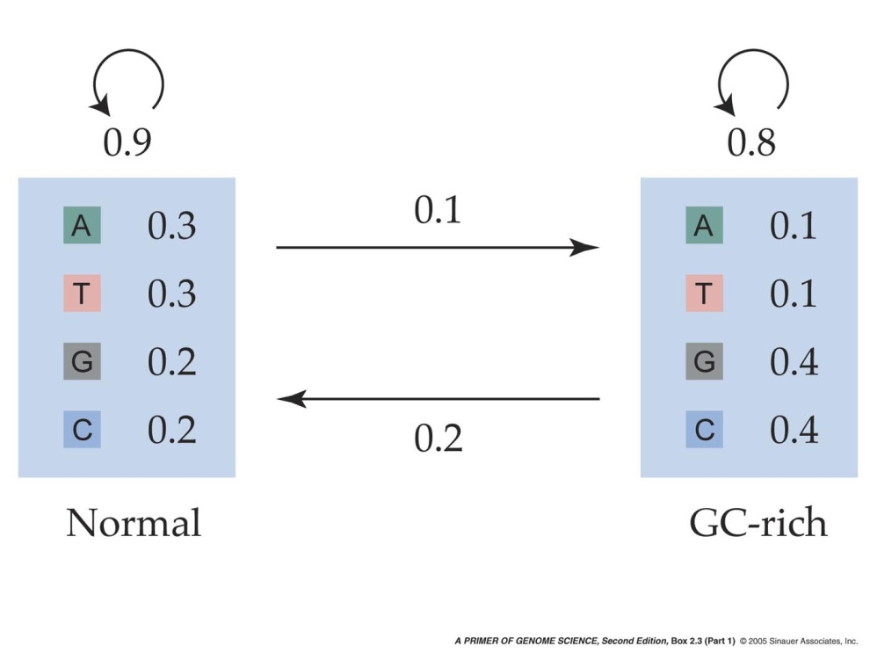
Box 2.3 (A) Hidden Markov Models and Gene Finding
Hidden Markov Models
Training the HMM
The states of the HMM are the two categories, N or R. Transition probabilities govern the assignment of stated from one position to the next. In the current example, if the present state is N, the following position will be N with probability 0.9, and R with probability 0.1. The four nucleotides in a seq. will appear in each state in accordance to the corresponding emission probabilities.
The working of an HMM → 2 steps
Assignment of the hidden states.
Emission of the observed nucleotides conditional on the hidden states
N
R
Notes:
pgs2e-box-02-03-1.jpg

Slide 37
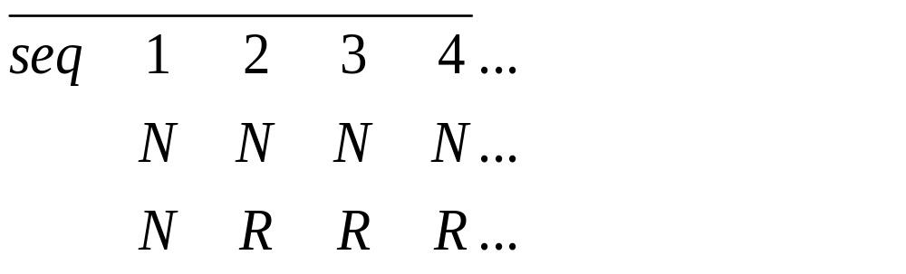
Hidden Markov Models
Consider the seq. TGCC arise from the set of hidden state NNNN. The probability of the observed seq. is a product of the appropriate emission probabilities:
Pr(TGCC|NNNN) = 0.3*0.2*0.2*0.2 = 0.0024
where Pr(T|N) = conditional probability of observing a T at a site given that the hidden state is N.
In general the probability is computed as the sum over all hidden states as:
1
2

Slide 38

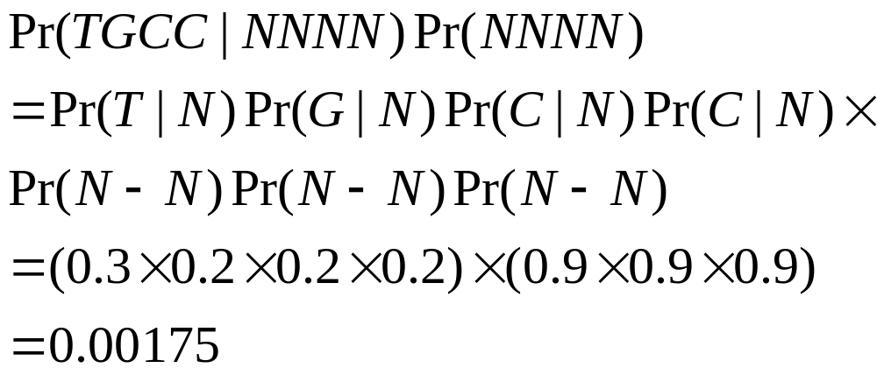
Hidden Markov Models
The description of the hidden state of the first residue in a seq. introduces a technical detail beyond the scope of this discussion, so we simplify by assuming that the first position is a N state ➔ 2*2*2=8 possible hidden states

Slide 39
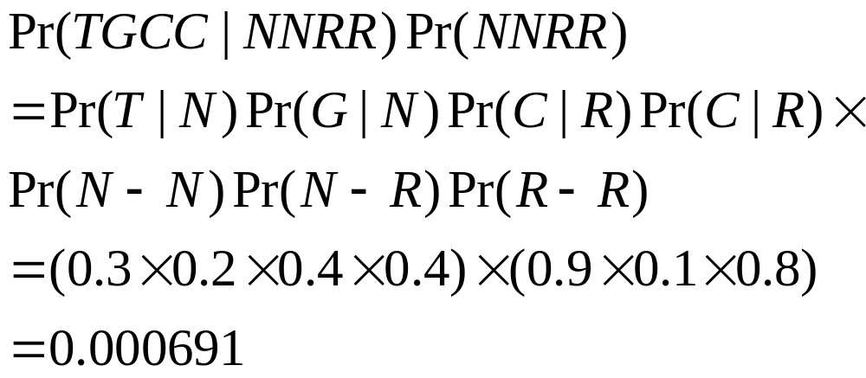
Hidden Markov Models
The most likely path is NNNN which is slightly higher than the path NRRR (0.00123).
We can use the path that contributes the maximum probability as our best estimate
of the unknown hidden states.
If the fifth nucleotide in the series were a G or C, the path NRRRR would be more
likely than NNNNN.

Slide 40
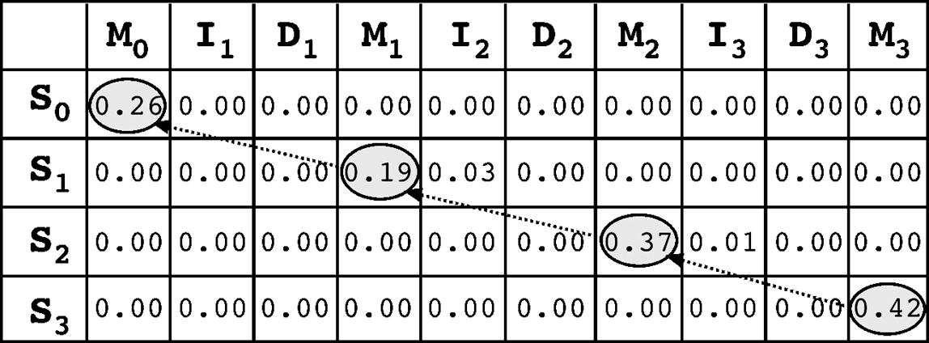
Hidden Markov Models
To find an optimal path within an HMM
The Viterbi algorithm, which works in a similar fashion as in dynamic programming for sequence alignment (see Chapter 3). It constructs a matrix with the maximum emission probability values all the symbols in a state multiplied by the transition probability for that state. It then uses a trace-back procedure going from the lower right corner to the upper left corner to find the path with the highest values in the matrix.

Slide 41
Hidden Markov Models
the forward algorithm, which constructs a matrix using the sum of multiple emission states instead of the maximum, and calculates the most likely path from the upper left corner of the matrix to the lower right corner.
there is always an issue of limited sampling size, which causes overrepresentation of observed characters while ignoring the unobserved characters. This problem is known as overfitting. To make sure that the HMM model generated from the training set is representative of not only the training set sequences, but also of other members of the family not yet sampled, some level of “smoothing” is needed, but not to the extent that it distorts the observed sequence patterns in the training set. This smoothing method is called regularization.
One of the regularization methods involves adding an extra amino acid called a pseudocount, which is an artificial value for an amino acid that is not observed in the training set.

Slide 42
HMM applications
HMMer (http://hmmer.janelia.org/) is an HMM package for sequence analysis available in the public domain.

